Slide 1

Continuous Evaluation Assignment - II
YUM HUB
: A Food Stall Application
Team Details:
Ayush Bansal 2210993778
Manya Saini 2210993814
Submitted by:
Rajan Kumar
:
Chitkara University Institute of Engineering and Technology,
Chitkara University, Punjab

Slide 2
Table of Contents
Introduction
Methodology
Tools and Technologies
Results
Conclusion and Future Scope
References

Slide 3
Introduction
The food industry is one of the most competitive industries globally, with large establishments dominating the market.
Small-scale food vendors often struggle to compete with these giants, resulting in a challenging environment for them to operate in.
Our project is designed to enhance the profitability and efficiency of small food vendors enabling them to expand their customer base and grow their business.
With our web-based solution, small food vendors can overcome the challenges they face in the industry and thrive in a highly competitive market.

Slide 4
Methodology
Requirement Analysis:
Conducted thorough market research to understand the needs and preferences of the target audience. Analyze the current trends in the food industry and identify gaps that small food vendors can fill.
Engage with stakeholders including small food vendors, customers, and industry experts to gather insights into their requirements and challenges. Understand their pain points and expectations from the solution.
Prioritize features based on their importance and feasibility. Determine essential functionalities such as menu management, order processing, payment integration, and customer communication to meet the needs of small food vendors effectively.
2. Technology Selection:
Chose a suitable web development framework Django based on factors like scalability, security, and ease of development. Consider the availability of libraries and community support.
Select a database management system like MySQL to store and manage data efficiently. Evaluate factors such as data integrity, scalability, and performance.

Slide 5
3. Architecture Design:
Utilize microservices to create a scalable and modular architecture, allowing for independent deployment and scaling. Separate functionalities like user authentication, menu management, and order processing into distinct services.
Define clear and consistent RESTful APIs for communication between frontend and backend components. Employ HTTP methods for CRUD operations and adhere to REST principles for resource naming and representation.
Implement caching mechanisms, load balancing, and horizontal scaling strategies to ensure scalability and high performance. Design the architecture to handle peak loads and accommodate future growth without sacrificing performance.
4. Implementation:
Develop the user interface using HTML, CSS, and JavaScript. Design responsive and intuitive UI elements for seamless navigation and enhanced user experience.
Implement backend logic using Django and Python. Develop APIs for handling user authentication, menu management, order processing, and other functionalities.
Conduct comprehensive testing including unit tests, integration tests, and end-to-end tests to ensure the reliability and functionality of the application.

Slide 6

Tools and Technologies
Django:
Facilitates rapid development of web applications.
Promotes clean and pragmatic design principles.
Provides built-in features for authentication, URL routing, templating, and database management.
Django ORM (Object-Relational Mapping):
Simplifies database access by mapping database tables to Python objects.
Allows developers to interact with the database using Python syntax.
Abstracts away the complexities of SQL queries.
Django Templates:
Enables creation of dynamic HTML pages using Django's template language.
Supports template inheritance, context variables, loops, and conditionals.
Facilitates code reusability and maintainability.

Slide 7

Tools and Technologies
Django Admin:
Provides a powerful tool for creating administrative interfaces.
Automatically generates CRUD interfaces based on model definitions.
Simplifies management of application data for administrators.
SQLite:
Integrated with Django by default.
Ideal for small to medium-sized web applications.
Simple and efficient for storing and retrieving data.
HTML, CSS, JavaScript:
HTML: Structures the content of web pages.
CSS: Styles and layouts the elements on web pages.
JavaScript: Adds interactivity and dynamic behavior to web pages.

Slide 8
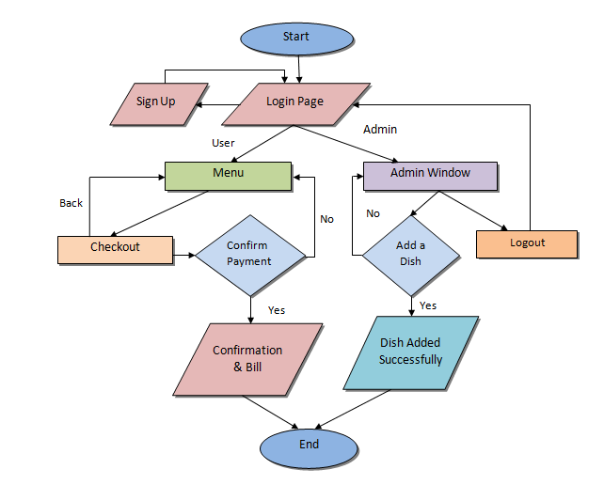
Flowchart

Slide 9
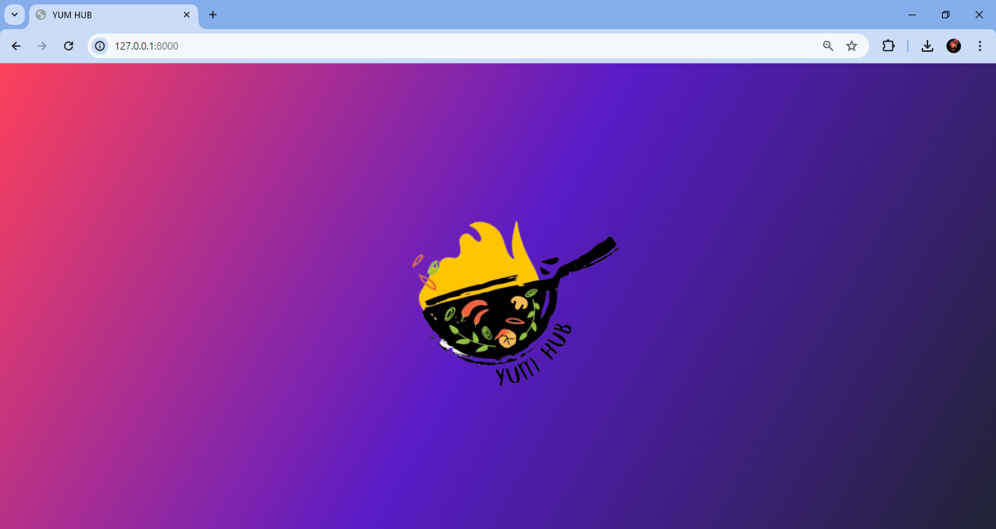
Outputs (YUMHUB)

Slide 10
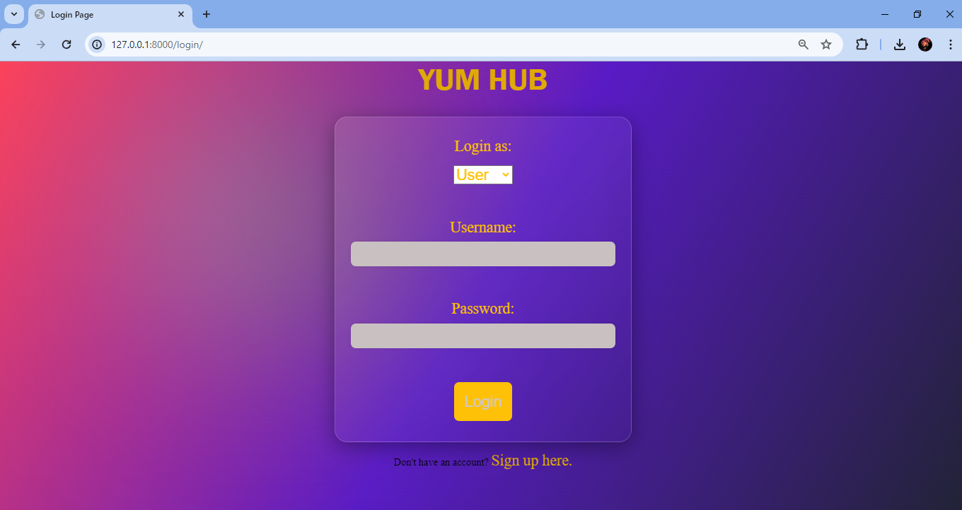
Login Page

Slide 11
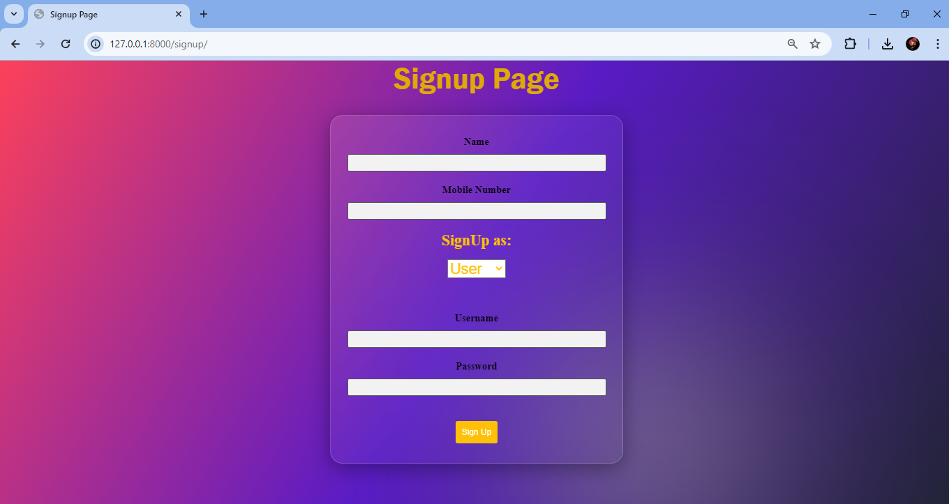
SignUp Page

Slide 12
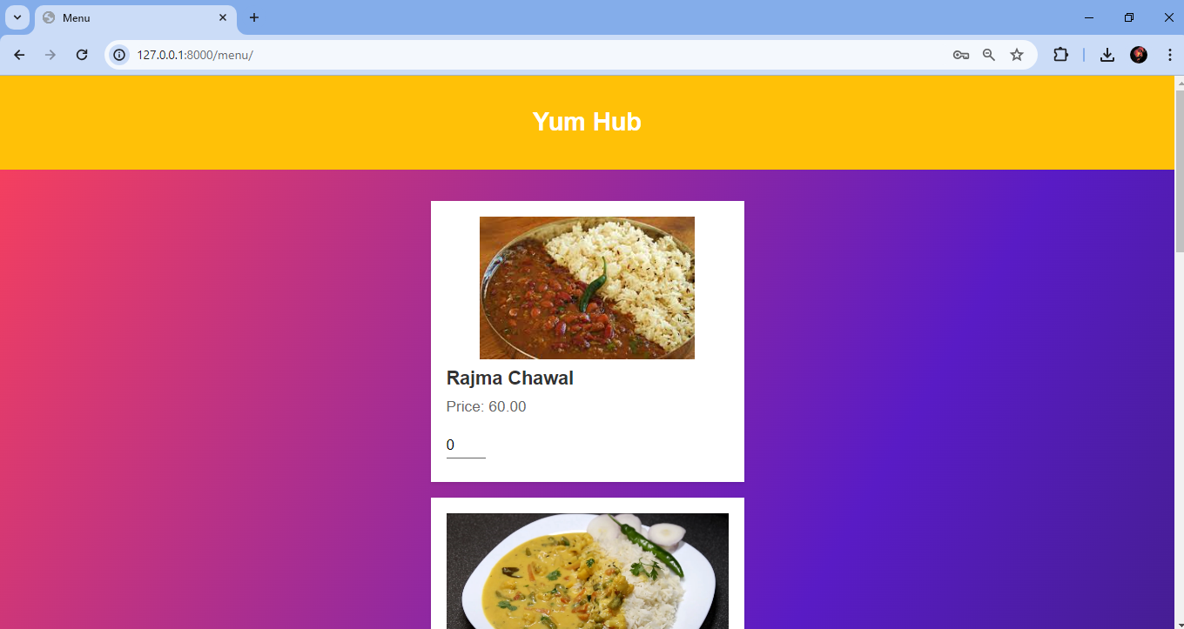
Menu

Slide 13
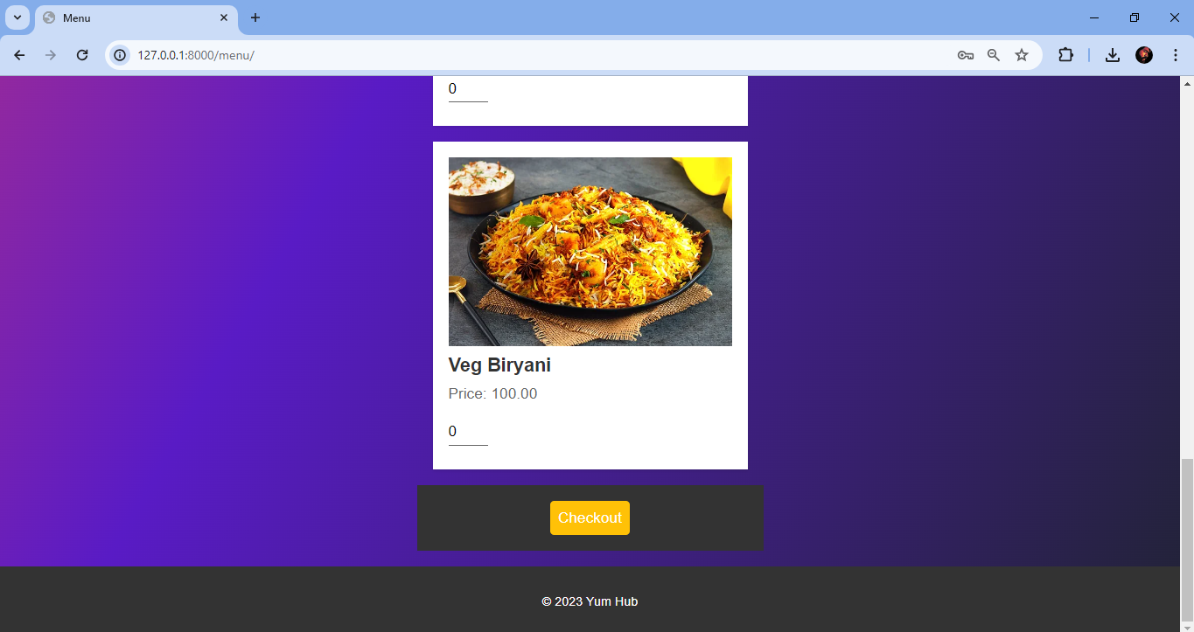
Menu

Slide 14
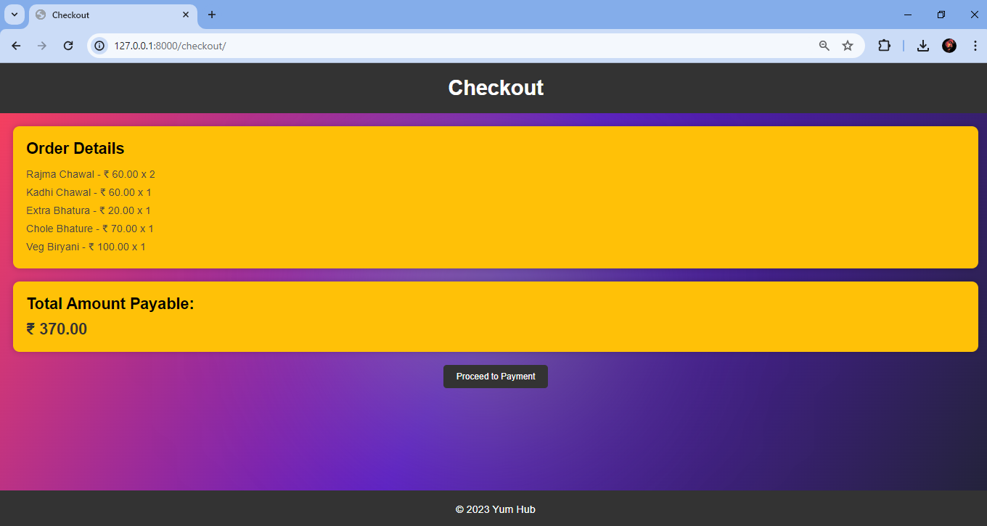
Checkout

Slide 15
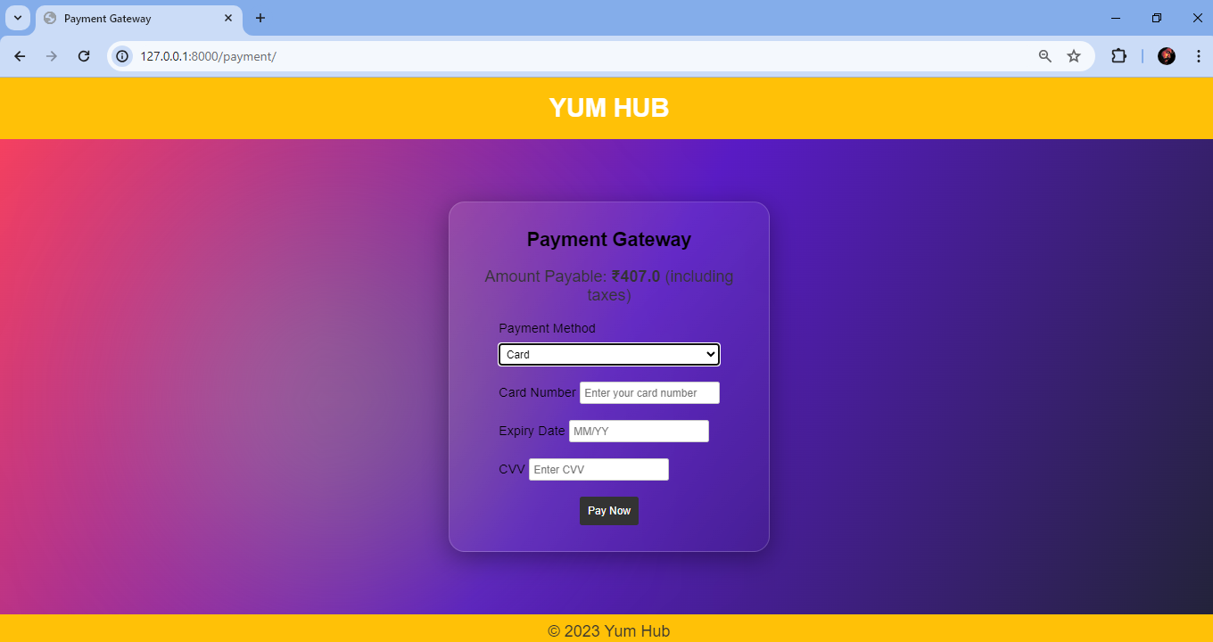
Payment Window

Slide 16
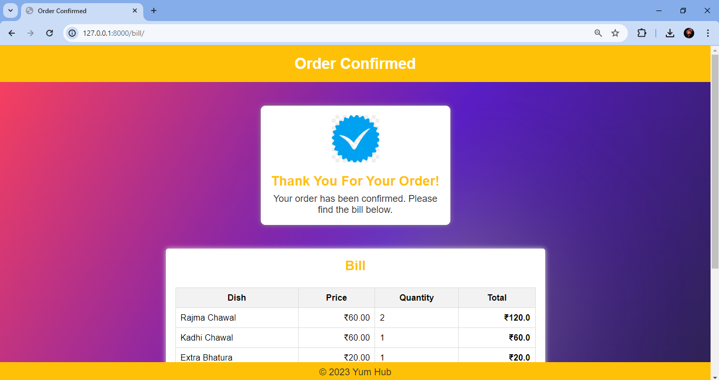
Order Confirmation

Slide 17
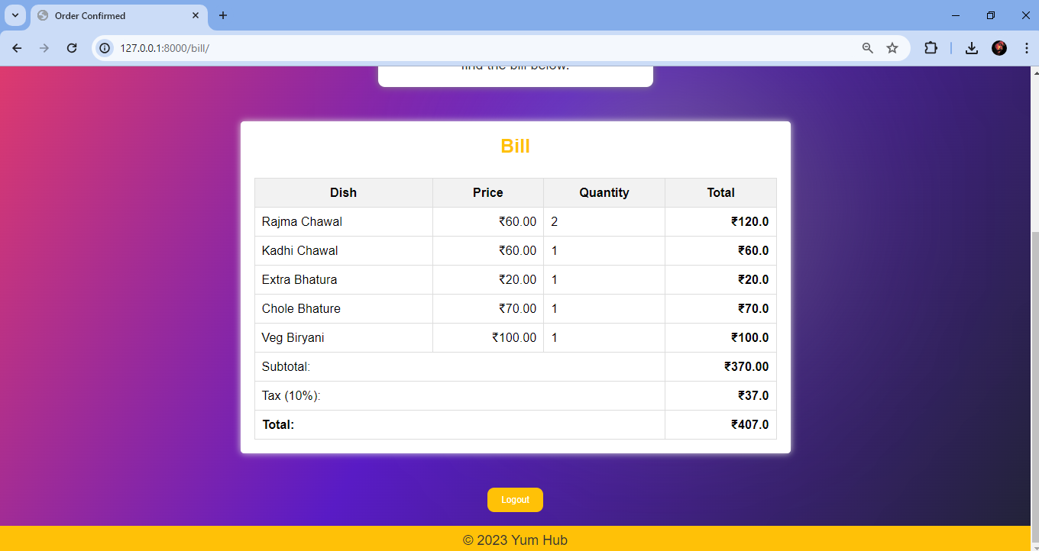
Order Bill

Slide 18
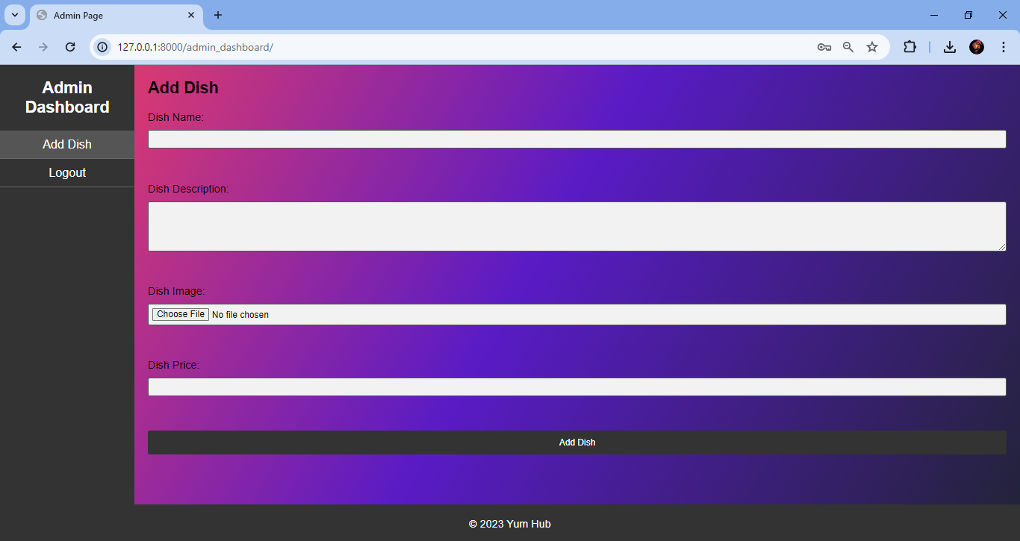
Admin Dashboard (Add a Dish)

Slide 19

Conclusion and Future Scope
Our project aims to revolutionize the way small food vendors operate in the highly competitive food industry.
By leveraging innovative technologies and strategies, we enable small vendors to overcome challenges and thrive in the market.
With a user-friendly interface, robust functionality, and scalability, our solution empowers vendors to grow their businesses and reach new heights of success.

Slide 20
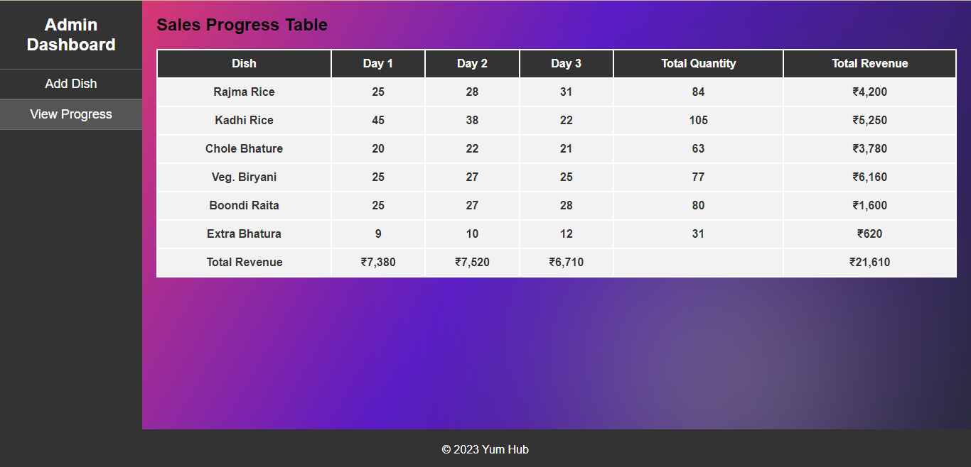
Conclusion and Future Scope
Future Enhancement and Expansion Opportunities:
View Progress Interface: In the future, we envision adding a sophisticated view progress window or interface for the admin dashboard. This feature will empower administrators to analyze trends in sales for each item over the past three days and overall sales of each item. By providing insights into sales performance, the admin can make informed decisions about inventory management, pricing strategies, and marketing efforts.

Slide 21
Conclusion and Future Scope
Future Enhancement and Expansion Opportunities:
Integration of AI Models: Another exciting enhancement involves the deployment of AI models to analyze sales data and provide actionable insights to vendors. By leveraging machine learning algorithms, our platform can identify patterns, trends, and correlations in sales data. These insights can help vendors optimize their offerings, predict future demand, and make strategic business decisions.
Payment APIs Integration: To facilitate real-world transactions seamlessly, we plan to integrate payment APIs and methods into our platform. This will enable users to make secure payments for their orders online, enhancing convenience and streamlining the checkout process. By offering multiple payment options, we can cater to diverse customer preferences and improve overall user experience.
Scalability and Expansion: Lastly, our focus will be on scaling the platform to reach as many vendors as possible and obtaining government authorization for widespread adoption. By expanding our network of vendors, we aim to democratize access to technology and empower small-scale food businesses to thrive in the competitive market landscape. Through strategic partnerships and regulatory compliance, we can ensure the widespread adoption and success of our platform.

Slide 22
References
“Restaurant Management System”
by Anjali Patil, Sneha Shinde and Vaishnavi Waghmare (International Journal of Research and Innovation in Computer Engineering, 2017).
Django Documentation:
Link: https://docs.djangoproject.com/en/5.0/
MDN Web Docs:
Link: https://developer.mozilla.org/en-US/ /
Django W3Schools
Link: https://www.w3schools.com/django/
SQLite Documentation
Link: https://www.sqlite.org/docs.html

Slide 23


